Slide 1
COME IN QUIETLY
HAVE ALL SUPPLIES READY WHEN THE BELL RINGS.
Take out a pen or pencil and binder paper.

Slide 2
Objective:
Evaluate the importance of the Magna Carta.
By the end of the lesson you should be able to:
Describe the importance of the Magna Carta.
Standard 8.1.4: Describe the nation’s blend of civic republicanism, classical liberal principles, and English parliamentary traditions.
Standard 8.2.1: Discuss the significance of the Magna Carta, the English Bill of Rights, and the Mayflower Compact.
RH 8.2: Determine the central ideas or information of a primary or secondary source; provide an accurate summary of the source distinct from prior knowledge or opinions.

Slide 3
Prior Knowledge
You have said the Pledge of Allegiance since you were in elementary school but most of you did not realize the significance of the phrase “and to the Republic for which it stands”. Now you know that phrase is stating that the government in America is a Republic.
On your paper, Describe a Republic?
Partner A share with Partner B “A Republic is _________.”
Partner B share with Partner A “I (agree/disagree) a Republic is ______.”
Republic - a representative government. The citizens elect representatives to vote on laws for them.

Slide 4
Concept - Definitions
Define:
Compact - a formal agreement or contract between two or more parties.
Charter - a written grant by which an institution is created and its rights and privileges defined.
Guaranteed - provide a formal assurance or promise.

Slide 5
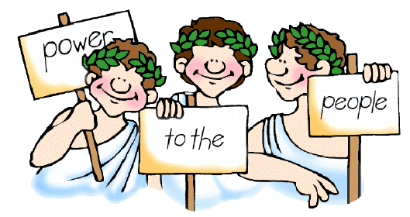
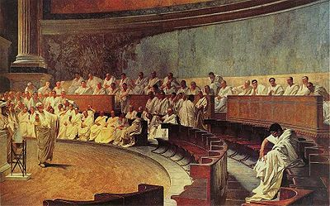
Concept
Democracy
Compact - a formal agreement or contract between two or more parties.
Charter - a written grant by which an institution is created and its rights and privileges defined.
Guaranteed - provide a formal assurance or promise.
A Democracy is a political system in which the supreme power lies in the citizens who can elect people to represent them.
The Athenians, from Athens Greece, had a Direct Democracy.
  Citizens gathered together and voted for their leaders, laws and policies.
The Romans had a Republic.
  Citizens voted for leaders to represent them.
  They introduced “rule of law”, the idea that laws apply equally to all citizens.
Are laws applied equally to all citizens in America today?

Slide 6
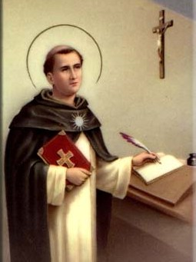
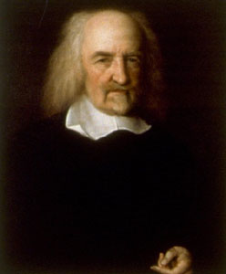
Concept
Natural Laws
Compact - a formal agreement or contract between two or more parties.
Charter - a written grant by which an institution is created and its rights and privileges defined.
Guaranteed - provide a formal assurance or promise.
Thomas Aquinas wrote that some laws were a part of human nature.
  He also claimed natural law gave people certain rights that governments should not take away.
Thomas Hobbes argued that an absolute monarchy, a king or queen with unlimited power, was the best form of government. He believed that people needed government to direct them.

Slide 7
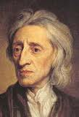
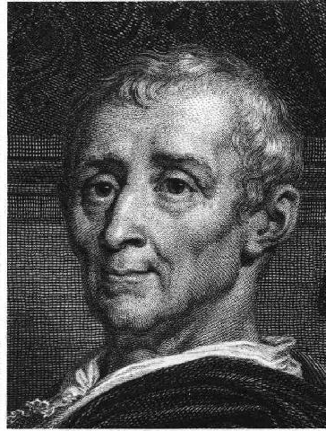
Concept
The Enlightenment
Compact - a formal agreement or contract between two or more parties.
Charter - a written grant by which an institution is created and its rights and privileges defined.
Guaranteed - provide a formal assurance or promise.
John Locke argued that people are born with natural rights.
  He claimed the purpose of government was to protect people’s natural rights.
  He said governments are based on a social contract or an agreement between rulers and the people.
Charles de Montesquieu claimed England’s government was best because it had a separation of powers.
  He claimed separation of powers kept governments from abusing natural rights.

Slide 8
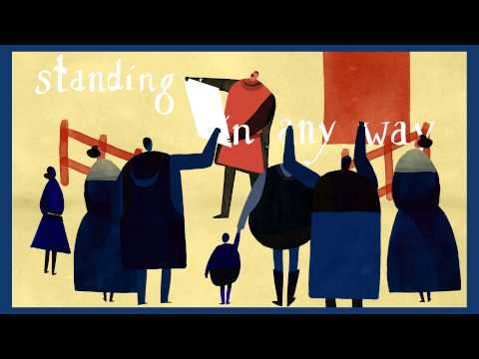
Concept
Magna Carta
Compact - a formal agreement or contract between two or more parties.
Charter - a written grant by which an institution is created and its rights and privileges defined.
Guaranteed - provide a formal assurance or promise.

Slide 9
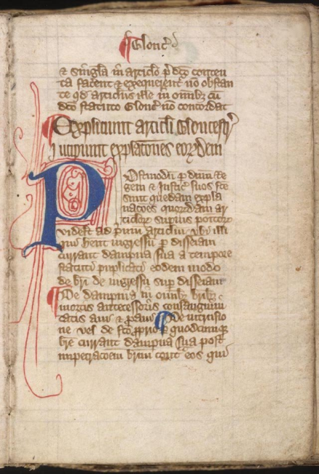
Concept
Magna Carta
Compact - a formal agreement or contract between two or more parties.
Charter - a written grant by which an institution is created and its rights and privileges defined.
Guaranteed - provide a formal assurance or promise.
The Magna Carta or “Great Charter” was signed in the year 1215.
It was a document that limited the powers of the English King for the first time.
It also guaranteed certain rights for the Nobles of England.
Why was the Magna Carta important?
What changes did the Magna Carta make?

Slide 10
Relevance
Rights were not always guaranteed for all citizens. It took many changes over time to get these rights.
How would government be different if the rights of citizens were not guaranteed?

Slide 11
Skill - I Do
Read the Text and Annotate using the following symbols.
Important Detail or Fact ★
Unfamiliar word or phrase
Interesting or Surprising !
Have a Question ?
Made a Connection C
¹The following is a true story. ²Once upon a time, around the year 1200, England was ruled by a cruel and wicked king named John. ³In those days kings could do anything they wanted. ⁴The people of England had to do whatever the king said; they had no choice.

Slide 12
Skill - I Do
Read the Text and Annotate using the following symbols.
Important Detail or Fact ★
Unfamiliar word or phrase
Interesting or Surprising !
Have a Question ?
Made a Connection C
¹The following is a true story. ! ²Once upon a time, around the year 1200, England was ruled by a cruel and wicked king named John. ³In those days kings could do anything they wanted. ⁴The people of England had to do whatever the king said; they had no choice.

Slide 13
Skill - I Do
Read the Text and Annotate using the following symbols.
Important Detail or Fact ★
Unfamiliar word or phrase
Interesting or Surprising !
Have a Question ?
Made a Connection C
¹The following is a true story. ! ²Once upon a time, around the year 1200, England was ruled by a cruel and wicked king named John.★ ³In those days kings could do anything they wanted. ⁴The people of England had to do whatever the king said; they had no choice.

Slide 14
Skill - I Do
Read the Text and Annotate using the following symbols.
Important Detail or Fact ★
Unfamiliar word or phrase
Interesting or Surprising !
Have a Question ?
Made a Connection C
¹The following is a true story. ! ²Once upon a time, around the year 1200, England was ruled by a cruel and wicked king named John.★ ³In those days kings could do anything they wanted.★ ⁴The people of England had to do whatever the king said; they had no choice.

Slide 15
Skill - I Do
Read the Text and Annotate using the following symbols.
Important Detail or Fact ★
Unfamiliar word or phrase
Interesting or Surprising !
Have a Question ?
Made a Connection C
¹The following is a true story. ! ²Once upon a time, around the year 1200, England was ruled by a cruel and wicked king named John.★ ³In those days kings could do anything they wanted.★ ⁴The people of England had to do whatever the king said; they had no choice.★

Slide 16
Skill - We Do
Read the Text and Annotate using the following symbols.
Important Detail or Fact ★
Unfamiliar word or phrase
Interesting or Surprising !
Have a Question ?
Made a Connection C
⁵If a man died and left his property to a son, King John took a large part of the inheritance for himself. ⁶If the man had no sons and left the property to his daughter, then the king would sell the daughter (and her inheritance) to the man who would pay the most money for her.

Slide 17
Skill - You Do
Read the Text and Annotate using the following symbols.
Important Detail or Fact ★
Unfamiliar word or phrase
Interesting or Surprising !
Have a Question ?
Made a Connection C
⁷King John was believed to have killed his own nephew. ⁸One noble lady foolishly was talking about this at a party. ⁹When King John heard that she was talking about it, he took all of her family’s wealth, kicked her husband out of England, and starved the lady and her son to death in a dungeon.

Slide 18
Skill - Independent Practice
Read the Text and Annotate using the following symbols.
Important Detail or Fact ★
Unfamiliar word or phrase
Interesting or Surprising !
Have a Question ?
Made a Connection C
Read and annotate the remaining 5 paragraphs.
Use your annotations to answer the 4 questions at the end of the document.

Slide 19
Closure
What was the importance of the Magna Carta?

